Slide 1
COS 212 B-Trees: Deletion

Slide 2
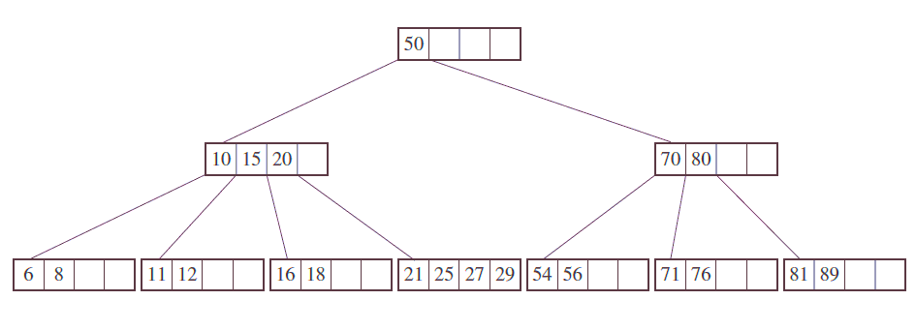
B-Trees: Delete
The hardest of the processes to apply
A reversal of insertion: Rather than splitting nodes, we will merge nodes as necessary so that B-tree properties still hold
Ensure that all non-root nodes must be at least half full
Two main cases to be considered
Deletion of a key from a leaf node
Deletion of a key from a non-leaf node

Slide 3
B-Trees: Deletion from a leaf
We’ll start with the simpler case: deleting from a leaf
In all cases we begin by searching for the value we want to delete, and removing that value
It may then be necessary to move values between nodes, and possibly merge nodes
There are two sub-cases to consider when deleting from a leaf
The leaf is at least half full after deleting the value
The leaf is less than half full after deleting the value

Slide 4
B-Trees: Deletion from a leaf
If the leaf is at least half full after deleting the desired value
All remaining keys in the leaf with larger values shift left one space
This fills the gap made by the deletion
Delete 6
16
3
8
22
25
1
2
5
7
6
7
13
14
15
18
20
23
24
27
37
2 keys, so leaf is still at least half full

Slide 5
B-Trees: Deletion from a leaf
The two sub-cases to consider when deleting from a leaf
The leaf is at least half full after deleting the value
We’ve just looked at this one
The leaf is less than half full after deleting the value (“underflow”)
There are two situations to take care of here
The leaf has a left or right sibling with a number of keys exceeding the minimum required (i.e. at least one sibling is more than half full)
Both siblings of the leaf have a number of keys that do not exceed the minimum required (i.e. both siblings are at most half full)

Slide 6

B-Trees: Deletion from a leaf
The leaf is less than half full after deleting the value
The node has a left or right sibling with a number of keys exceeding the minimum required
Choose one of the siblings satisfying this requirement (if only one sibling satisfies the requirement, that sibling must be chosen)
Combine all keys from the leaf containing the deleted value, the leaf’s chosen sibling, and the leaf’s parent key into a combined list
Replace the leaf’s parent key with the middle key in the combined list
Redistribute all remaining keys in the combined list between the leaf and its chosen sibling
Delete 7
16
3
13
22
25
8
1
2
5
7
8
13
14
14
15
15
18
20
23
24
27
37
1 key, so leaf is less than half full
Only the right sibling is more than half full
5, 8, 13, 14, 15
$$i=\left\lceil n/2\right\rceil =3$$

Slide 7
B-Trees: Deletion from a leaf
The leaf is less than half full after deleting the value
All siblings of the leaf have a number of keys that do not exceed the minimum required
Choose either one of the siblings (if the leaf is the leftmost or rightmost child of its parent, only one sibling can be chosen)
Take all keys from the leaf containing the deleted value, the leaf’s chosen sibling, and the leaf’s parent key, and redistribute them into either the leaf or its sibling (whichever is the leftmost node)
Discard the leaf or its sibling that is empty after the redistribution, and shift the keys in the parent to fill the gap left by the leaf’s parent key
This may cause the parent to underflow. If so, treat the parent as a leaf and repeat the deletion algorithm on it
Delete 8
16
13
Underflow!
3
22
25
13
1
2
5
8
14
15
14
15
18
20
23
24
27
37
1 key, so leaf is less than half full
Neither sibling is more than half full
We’ll choose the right sibling for this example
5, 13, 14, 15

Slide 8
B-Trees: Deletion from a leaf
3, 16, 22, 25
Treat underflowing parent as a leaf & repeat deletion algorithm
The sibling is not more than half full
1 key, so node is less than half full
16
We must merge into a single node
Underflow!
3
16
22
25
22
25
1
2
5
13
14
15
18
20
23
24
27
37
We must now deal with the underflow
We must be sure to also move the pointers with their corresponding keys
Note that the root and sibling nodes are now empty, so they must be discarded

Slide 9
B-Trees: Deletion from a leaf
An exercise for you
Start with the original tree from the previous example (below)
Once again delete 8
But this time merge the leaf node that the 8 is deleted from with its left sibling, instead of its right sibling
Delete 8
16
3
13
22
25
1
2
5
8
14
15
18
20
23
24
27
37

Slide 10
B-Trees: Deletion from a non-leaf
To avoid problems with B-tree balancing, non-leaf deletion is reduced to leaf deletion
Replace deleted key with the value of one of the following
Deleted key’s immediate predecessor: Largest key smaller than the deleted key Deleted key’s immediate successor: Smallest key larger than the deleted key
Immediate predecessor and successor will always be in a leaf node
How should we find the immediate predecessor and immediate successor?
The immediate predecessor (or successor) is then deleted
Because these are always in leaf nodes, this is a normal leaf deletion that follows the procedure we’ve already discussed
Delete 16
15
3
16
22
25
1
2
5
13
14
15
18
20
23
24
27
37
We’ll choose the immediate predecessor for this example
Now we have to delete the predecessor (leaf deletion)
3 keys after deletion, so leaf is at least half full

Slide 11

B-Trees: Deletion from a non-leaf
The deletion can behave very differently depending on whether the immediate predecessor or successor is chosen
To illustrate this
We’ll redo the previous example
But choose the immediate successor, instead of the immediate predecessor
$$i=\left\lceil n/2\right\rceil =3$$
Delete 16
5, 13, 14, 15, 18, 20
16
18
3
14
22
25
15
18
14
15
20
20
1
2
5
13
18
20
23
24
27
37
We’ll choose the immediate successor for this example
Now we have to delete the successor (leaf deletion)
1 key after deletion, so leaf is less than half full
Only the left sibling is more than half full

